Slide 1
PyBev
Daily Metrics Updates
with Python

Slide 2
What do we do every day?
Download MCAP data through Spotfire
Create a pivot table of ad counts
VLOOKUP this data to fill our Panel Metrics
Identify missing/incomplete items
Investigate problems
Solve or at least initiate solutions to problems
Setting up the data takes ~15 minutes
Problem identification can be anywhere from 30 minutes to multiple hours, depending on the day

Slide 3
Project Goals
Pull data from MCAP directly (no more Spotfire)
Pivot and read in the data to the Metrics document
Identify problem items
Attempt common problem troubleshooting (checking for indexed ads, unpublished circulars, etc.)
Generate report for Coverage team member to investigate
Archive data every Monday
User just needs to enter dates and solve the actual problems, no more time spent tracking down the same issues over and over again in a single day
Automation means increased consistency in error reporting

Slide 4
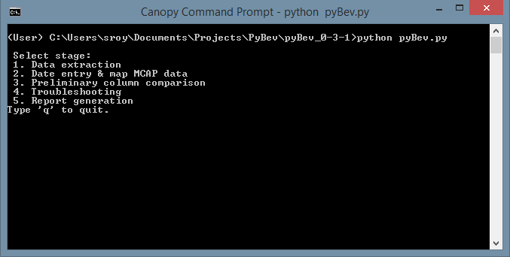
Project Run Stages
Stage 1: Data Extraction
Stage 2: Date Entry & Metrics Mapping
Stage 3: Preliminary Column Comparison (Naïve Updates)
Stage 4: Troubleshooting
Stage 5: Report Generation

Slide 5
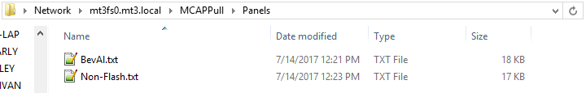
Stage 1: Data Extraction
Using the APIMA auto-query of the MCAP database, extract YTD data of a given list of retailers.
Located on \\mt3fs0.mt3.local\MCAPPull
Automatically runs every 15 minutes
Panel lists are text files inside \\mt3fs0.mt3.local\MCAPPull\Panels, and can be easily edited by Ops as they change
Data extracted contains:
Retailer
Market
WeekOf
BreakDt
EndDt
QCDt
QCDt – BreakDt (the processing delay)
Vehicle ID
Flyer ID
Sender

Slide 6
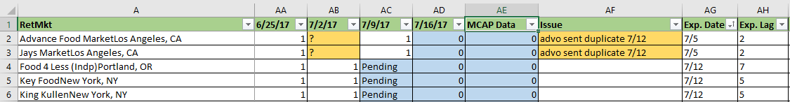
Stage 2: Date Entry & Metrics Mapping
User enters the week that they want to check
Program pulls the relevant information and writes it to the Metrics file for live analysis by the user
Week must be entered in MM/DD/YYYY format, but entering any day will be automatically converted to the first day of the week
By default, updates the “MCAP Data” column:

Slide 7
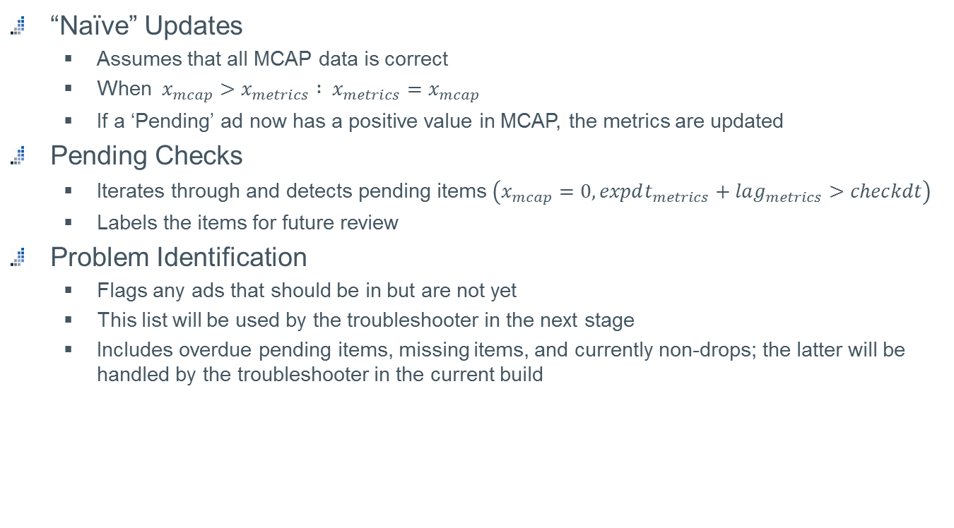
Stage 3: Preliminary Column Comparison
“Naïve” Updates
Assumes that all MCAP data is correct
When $x_{mcap}>x_{metrics} : x_{metrics}=x_{mcap}$
If a ‘Pending’ ad now has a positive value in MCAP, the metrics are updated
Pending Checks
Iterates through and detects pending items $\left(x_{mcap}=0, expdt_{metrics}+lag_{metrics}>checkdt\right)$
Labels the items for future review
Problem Identification
Flags any ads that should be in but are not yet
This list will be used by the troubleshooter in the next stage
Includes overdue pending items, missing items, and currently non-drops; the latter will be handled by the troubleshooter in the current build

Slide 8
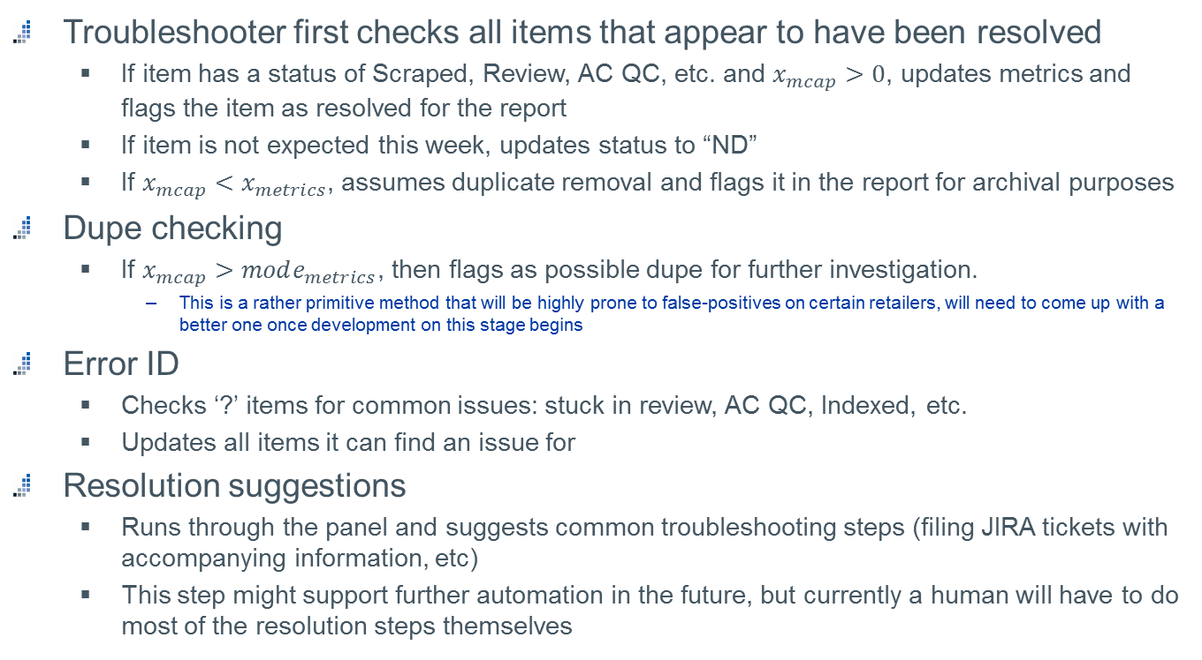
Stage 4: Troubleshooting
Troubleshooter first checks all items that appear to have been resolved
If item has a status of Scraped, Review, AC QC, etc. and $x_{mcap}>0$, updates metrics and flags the item as resolved for the report
If item is not expected this week, updates status to “ND”
If $x_{mcap}<x_{metrics}$, assumes duplicate removal and flags it in the report for archival purposes
Dupe checking
If $x_{mcap}>mode_{metrics}$, then flags as possible dupe for further investigation.
This is a rather primitive method that will be highly prone to false-positives on certain retailers, will need to come up with a better one once development on this stage begins
Error ID
Checks ‘?’ items for common issues: stuck in review, AC QC, Indexed, etc.
Updates all items it can find an issue for
Resolution suggestions
Runs through the panel and suggests common troubleshooting steps (filing JIRA tickets with accompanying information, etc)
This step might support further automation in the future, but currently a human will have to do most of the resolution steps themselves

Slide 9
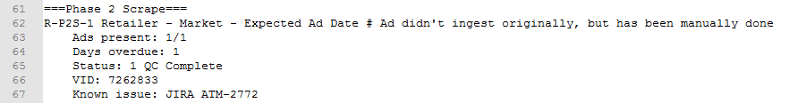
Stage 5: Report Generation
With the data produced by the troubleshooter, the program generates a report
Lists all resolved and unresolved issues, each given an identification code in the format:
Resolved/Unresolved – Media – Number – Retailer – Market – Expected Ad Date
Every issue has a brief description of the problem and recommended solution, as well as all information relevant to the problem
Present ad count
Ad statuses
Ad VIDs
Known Issues
Various other attributes depending on the issue type
Report is a small text file that can easily be archived
Example:

Slide 10
Future Plans
Current version 0.3.1 – column comparison
v1.0 – fully functional script works on a computer with Python packages installed
v2.0 – compiled exe should work on any windows computer, possible addition of basic GUI
v3.0 – inclusion of historical data checking functionality & analysis (BASS)?

